Slide 1
IMDB MOVIE ANALYSIS

Slide 2
Introduction
Project Description:
Objective: Identify factors that influence a movie's success on IMDB, defined by high ratings.
Data Cleaning: Preparing the data by handling missing values, removing duplicates and converting data types.
Data Analysis: Examining relationships between various factors and IMDB ratings. Analyzing genres, movie durations, languages, directors, and budgets.

Slide 3
Tech Stack Used
Tools Used:
Microsoft Excel: For data manipulation, statistical analysis, and visualization.
Microsoft Power Point: For preparing report and presentation.

Slide 4
Tasks
Genre Analysis: Identifying common genres and their impact on IMDB scores. Calculate mean, median, mode, range, variance, and standard deviation for each genre.
Duration Analysis: Studying the distribution of movie durations and their correlation with IMDB scores and using scatter plots and trendlines.
Language Analysis: Determining the most common languages in movies and analyze their impact on IMDB scores. Calculate mean, median, and standard deviation.
Director Analysis: Find top directors based on average IMDB scores. Use percentile calculations to compare their success rates.
Budget Analysis: Explore the relationship between budgets and financial success. Calculate correlation coefficients and identify movies with the highest profit margins.

Slide 5
Data Cleaning
Handling missing values: Identified and handled missing values by removing them.
Removing duplicates: Identified duplicate rows, there were 45 duplicate rows and removed them.
Removing Unwanted Data: Identified the data which would not be useful for the analysis and removed them.

Slide 6
Five 'Whys' Approach
Q: Why are certain movie genres more popular and have higher IMDB ratings?
A: These genres tend to align with audience preferences and current trends.
Q: Why do audience preferences and trends impact IMDB ratings?
A: Movies that match audience interests generate more engagement and positive reviews.
Q: Why do movies with certain durations tend to have higher or lower IMDB ratings?
A: The duration can affect the pacing and storytelling quality, influencing viewer satisfaction.
Q: Why do storytelling quality and pacing affect viewer satisfaction?
A: Well-paced movies keep viewers engaged and entertained, leading to higher ratings.
Q: Why do movies in certain languages receive higher IMDB ratings?
A: Movies in widely spoken or culturally significant languages reach a larger and more diverse audience.

Slide 7
Movie Genre Analysis
Movie Genre Analysis: Analyze the distribution of movie genres and their impact on the IMDB score.
My Task: Determine the most common genres of movies in the dataset. Then, for each genre, calculate descriptive statistics (mean, median, mode, range, variance, standard deviation) of the IMDB scores.
Click here to go to the Excel File.

Slide 8
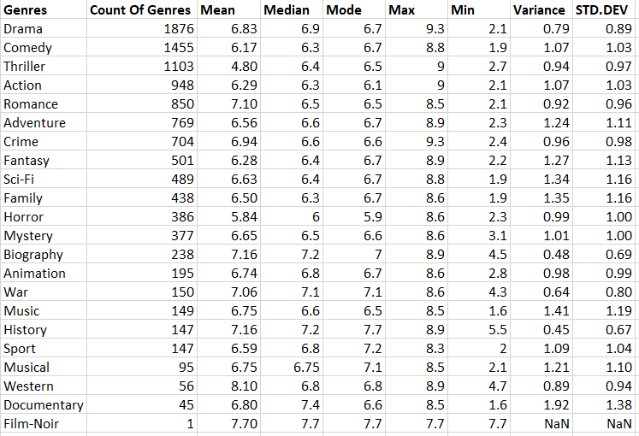
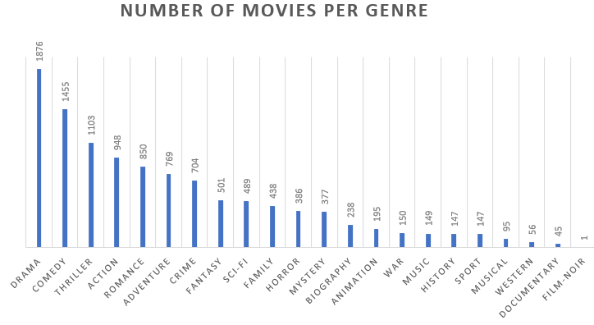
The table below shows the descriptive statistics for IMDB scores by genre:
Drama is the most common genre, followed by Comedy and Thriller.
Biography and History genres have the highest average IMDB scores, indicating they tend to be well-received by audiences.
Horror and Comedy have lower average scores, suggesting these genres might have a more mixed reception.

Slide 9
Movie Duration Analysis
Movie Duration Analysis: Analyze the distribution of movie durations and its impact on the IMDB score.
My Task:
Analyze the distribution of movie durations and identify the relationship between movie duration and IMDB score.
Create a scatter plot to visualize the relationship between movie duration and IMDB score, and add a trendline to assess the relationship.
Click here for excel file

Slide 10
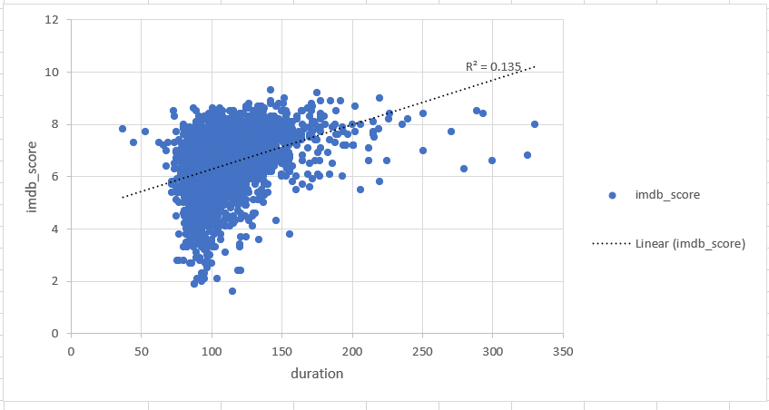
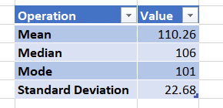
The descriptive statistics for movie durations are as follows:
Mean Duration: 110.26 minutes
Median Duration: 106 minutes
Mode Duration: 101 minutes
Standard Deviation: 22.68 minutes
The scatter plot with the trendline shows the relationship between movie duration and IMDB score. The trendline indicates a slight positive correlation, suggesting that longer movies tend to have slightly higher IMDB scores.

Slide 11
Language Analysis
Language Analysis: Examine the distribution of movies based on their language.
My Task: Determine the most common languages used in movies and analyze their impact on the IMDB score using descriptive statistics.
Click here for excel file.

Slide 12
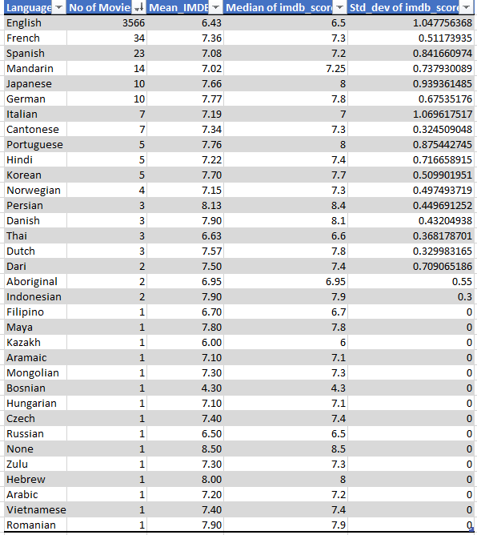
The table shows IMDb scores across various languages, with English having the highest number of movies (3566) and a mean IMDb score of 6.43.
Persian and Danish movies have the highest mean IMDb scores of 8.13 and 7.90, respectively, indicating strong audience appreciation.
The standard deviation of IMDb scores varies, with English movies having a higher variability (1.047) compared to other languages, suggesting a wider range of ratings.

Slide 13
Director Analysis
Director Analysis: Influence of directors on movie ratings.
My Task: Identify the top directors based on their average IMDB score and analyze their contribution to the success of movies using percentile calculations.
Click here for excel file

Slide 14
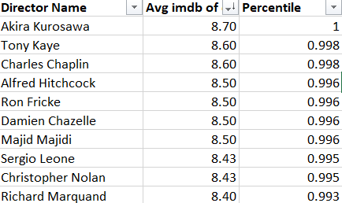
Top Director: Akira Kurosawa holds the highest average IMDb score of 8.70, placing him in the 1st percentile, indicating exceptional acclaim.
High Ratings: All listed directors have average IMDb scores above 8.40, showcasing their ability to produce highly rated films.
Diverse Talent: The table features directors from various eras and regions, highlighting the global cinematic excellence.

Slide 15
Budget Analysis
Budget Analysis: Explore the relationship between movie budgets and their financial success.
My Task: Analyze the correlation between movie budgets and gross earnings, and identify the movies with the highest profit margin.
Click here for excel file

Slide 16
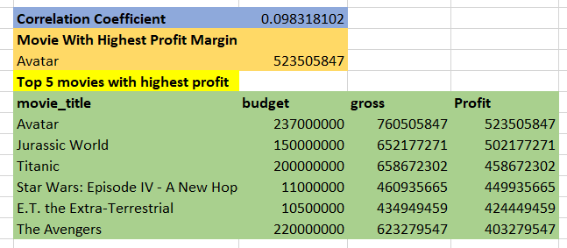
Highest Profit Margin: “Avatar” has the highest profit margin of $523,505,847, showcasing its massive financial success.
Top Budget Films: The table lists the top 5 movies with the highest budgets, including “Avatar,” “Jurassic World,” and “Titanic,” highlighting the significant investment in these blockbuster films.
Correlation Coefficient: The correlation coefficient of 0.09831802 suggests a weak relationship between budget and profit, indicating that higher budgets do not necessarily guarantee higher profits.

Slide 17
Summary and Insights
Movie Genre Analysis: Drama (1876) and Comedy (1455) have the highest number of movies, suggesting these genres are the most prevalent.
Movie Duration Analysis: Longer movie duration tend to have slightly higher IMDB scores.
Language Analysis: Persian and Danish movies have the highest mean IMDB scores of 8.13 and 7.90, respectively, indicating strong audience appreciation. This showcases the diverse appeal and quality of films across different languages.
Director Analysis: Akira Kurosawa stands out with the highest average IMDB score of 8.70, placing him in the 1st percentile. This highlights his exceptional acclaim and influence in the film industry.
Budget Analysis: “Avatar” leads with the highest profit margin of 523,505,847, demonstrating its massive financial success. This underscores the significant impact of high-budget films on profitability.

Slide 18
Conclusion
In this project I achieved the following:
Genre Popularity and Impact: Identified the most common movie genres and found that some genres consistently receive higher IMDB scores, indicating audience preferences or higher quality.
Descriptive Statistics: Calculated key statistics like mean, median, mode, range, variance, and standard deviation for IMDB scores within each genre, giving a clear picture of how different genres perform.
Visual Insights: Created scatter plots and charts to visually represent the relationship between movie genres and IMDB scores, making it easier to understand the data.
Actionable Recommendations: Provided insights that can guide future movie projects and marketing strategies by highlighting which genres tend to perform better.
Comprehensive Analysis: Combined data manipulation, statistical analysis, and visualization to thoroughly analyze the dataset and address the problem statement effectively.

